Slide 1
HL7 Vocabulary
Nutrition Terminology Discussions
Sept 2013 – THUR Q4

Slide 2
Agenda
Nutrition Terminology Needs
Diet Orders (new SNOMED US Ext Dietary Regimes/Therapies)
Allergies to food substances
Nutritional Supplements & Enteral Formula Products
Generic or Manufactured Product specifics
Challenges for V3 and V2
Other ?

Slide 3
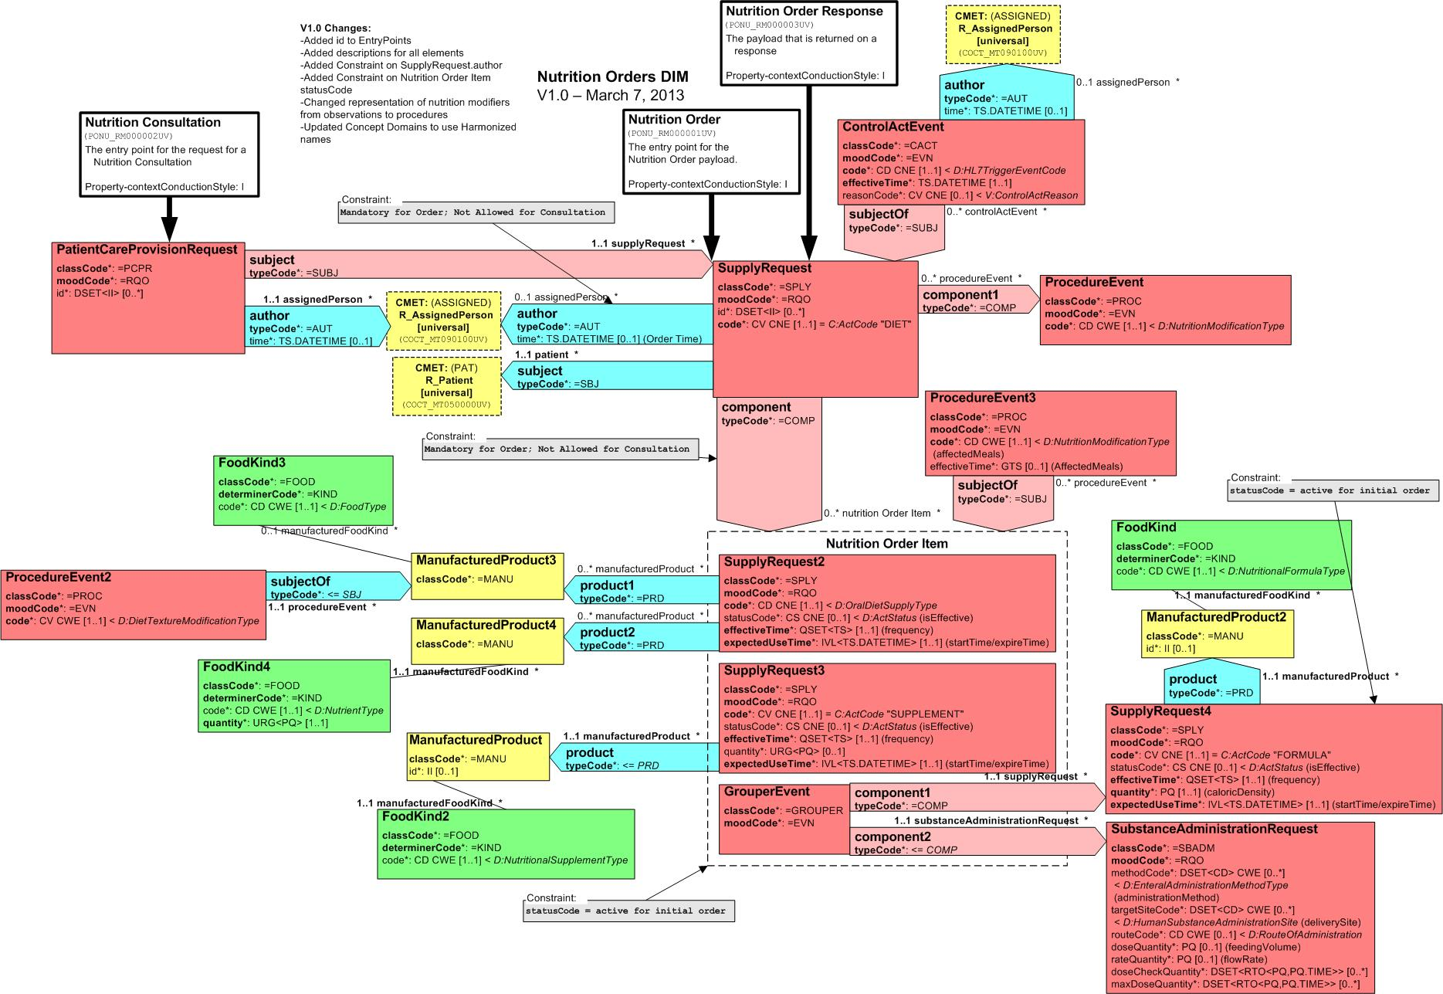
Version 3 Nutrition DMIM
1
2
4
8
5
3
6
7
9

Slide 4
Procedure Events (items 1 & 2)
Oral Diet (Item 1)Procedure Event
Use the CWE “Nutrition Modification Type”
Can have only one (oral?)
Procedure event 3 (affected meals)
Is that vegan, etc or consistent CHOtype
Nutritional Supplement (Item 2? Or only supply request?)
Can have one to many
Enteral Formula
Can have one to many

Slide 5
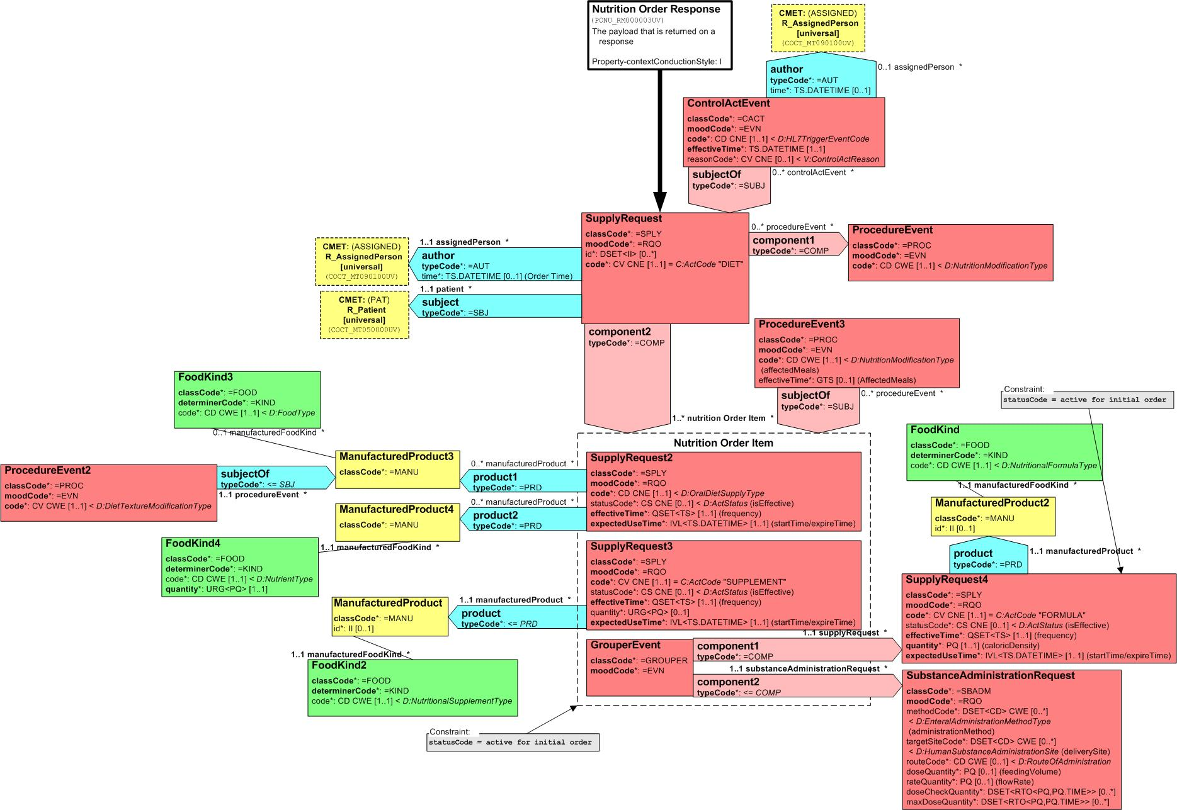
Nutrition Order RMIM

Slide 6
Nutrition Modification Type
Note that two fields have the same code set
We can use these in different ways or the same ways
One to many terms possible (oral, supplement or formula?)(is that procedure event?)
Modifies the entire diet (procedure event 3)
Kosher
Vegan
Texture modified?

Slide 7
Nutrition Order RMIM

Slide 8
Oral Diet Supply Type (Item 3)
CNE – reads “oral diet supply type”

Slide 9
Nutrition Order RMIM

Slide 10
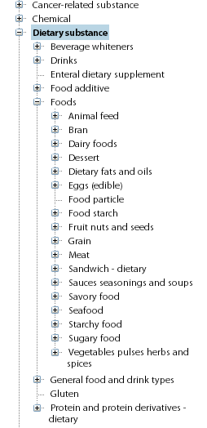
Food Type (Item #4) Food kind 3
Is this complete or do we need to add SNOMED codes?

Slide 11
Nutrition Order RMIM

Slide 12
Diet Texture Modification Type (#5)
The texture modifier modifies the food type
E.g. meat – chopped, fruit - diced
SNOMED Codes for (use here ??)
Thin liquid diet
Nectar thick liquid diet
Honey thick liquid diet
Spoon thick liquid diet
Other terms currently in SNOMED under Substance (check for liquid modifiers)
Can we add negation (e.g. no crunchy foods?)

Slide 13
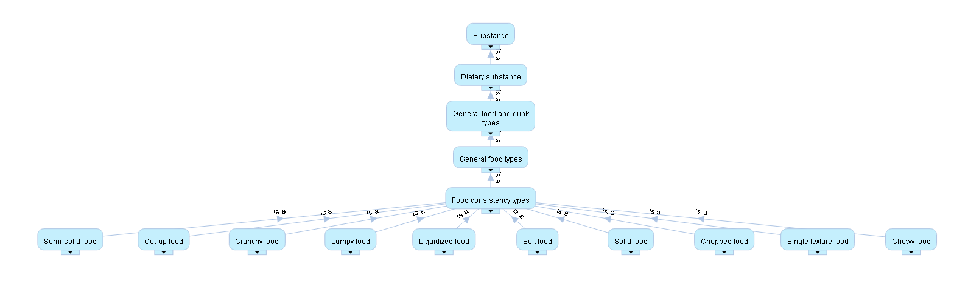
Food Consistency Types (SNOMED)

Slide 14
Nutrition Order RMIM

Slide 15
Nutrient Type (Item #6)
Intervention terms? (SNOMED codes from regimes and therapies)
Carbohydrate modified diet
Consistent carbohydrate diet
Galactose modified diet
Lactose modified diet
Cholesterol modified diet
Post coordination?
Quantity code set?

Slide 16
Nutrition Order RMIM

Slide 17
Supplement (Item #7)
Nutritional Supplement Type
Source of codes or code classes?
Protein modified
Carbohydrate modified
Fat modified
Do we post coordinate regime and therapy types
Commercial Products representation?
SNOMED Codes for enteral supplements
2661197012 Enteral dietary supplement (substance) FullySpecifiedName (3) Current (0)
2673841019 Enteral dietary supplement Preferred (1) Current (0)
Parents (1)
Dietary substance [ 116273005 ]

Slide 18
Nutrition Order RMIM

Slide 19
Formula
Nutritional Formula Type
Code set?
Baby Formula (infant formula SNOMED Code – substance is 412413001)

Slide 20
Nutrition Order RMIM

Slide 21
Enteral Administration Method Type
Need codes for
Continuous drip
Bolus
Aliquot per time

Slide 22
Nutrition Order RMIM

Slide 23
Existing Code Sets
Route of Administration
Human Substance Administration Site
? Where LOINC fits in
Other OIDS for food and diets

Slide 24
Sample XML Messages
Oral Diet with Consistent Carb and Nutrition limits
Consistent Carb with meal-specific limits
Renal with limits
Regular with modifications
NPO Order
Enteral Order
Here are the questions:
1) For the Oral Diet with Consistent Carb and a bunch of limits, what would the order item diet code be? We can make a case for four different codes:
-GeneralDiet
-GeneralDietWithMod
-ConsistentCarb
-ConsistentCarbWithMod
For the GeneralDiet codes, the ConsistentCarb would then be placed as just another modifier to the order.
MKD – Let’s model using our new list of SNOMED diets, e.g., Consistent Carbohydrate Diet. Then we need to see if we can outline the quantitative requirements using the message quantity and timing elements, e.g. 45 grams CHO at Breakfast, Essentially we need to flush out if we can avoid doing LOINC work.

Slide 25
2) For the meal-specific limits, we realize that we need to add a Participation.time value to the various product participation so that we can restrict when those modifications take place. This will be our first DSTU comment.
MKD – Yep – I think this is in line with example for #1 above.
3) For the modifier of Low Lactose, is there a definition of what "Low" means? Or should that just be a code, eg. LowLactose?
MKD – We tried to avoid the use of High or Low and went with the approach of increase/decrease - but we will need to fill in the “how much” detail.
4) For Enteral Formulas, does the formula product code indicate the various nutrient limits or is it expected that those would be specified beyond the code? I.e. if I want to say that the formula must have 1.2-1.5 g protein per ideal kg, is that an additive to the formula that needs to be specified separately or do I just pick an appropriate formula code?
MKD – For an additive and in infant formulas, you might write the order for a specific amount of additional Protein or Carbohydrate (this would come in the form of a product such as Beneprotein or Polycose). Typically, we’d see this as just a formula code. Generic 1 Kcal/mL Formula versus a 1.2 or 1.5 Kcal/mL Formula or Specialty ARDS Formula.

Slide 26
For fun. . . here is a real V2 diet order (1st ODS) and supplement (2nd ODS) that I’m dealing with that is valid and problematic (to say the least).
ORC|NW|001XYG402^SCM|||IP|| - truncated to mask
ODS|D||Kosher~Pureed/Blended~13-17 months~Honey Consistency~Diet_Rest_Fluid CHS~Lactose Restricted~ Sucrose Restricted~ Galactose Restricted~ No Milk~ No Milk Products~No Caffeine~Increased Calories~ Increased Protein~No Concentrated Sweets~ No Sweetened Beverages~High Fiber~Lacto Ovo~Gluten Free~Consistent Vitamin K Intake~High Calcium~ High Iron~ High Potassium~ Low Phosphorus ODS|S|2~4~6|Instant Breakfast Milkshake - Ice Cream

